Slide 1
Project Group 18 UST Freshmen Chatbot
Chan Yee San Samuel
Leung Cheuk Nam
Liu Yan Ho
Fung Yuk Cheung
Lai Yui Fung

Slide 2
Basic Hierarchy of our chatbot
Category
<- Academic
<- Course
<- CourseWebsiteSearch
<- CreditTransfer
<- Staff
<- Campus
<- CampusETA
<- Function
<- TimeTable
<- Social
<- Recreation
<- Societies
<- Transport
<- Bus
<- Minibus
<- Instruction

Slide 3
Academic <- Course
-

Slide 4
Academic <- CourseWebsiteSearch
-

Slide 5
Academic <- CreditTransfer
Provide credit transfer information for students
taken local / non-local examinations, e.g. HKALE, GCEAL
promoted from local institution
in exchange

Slide 6
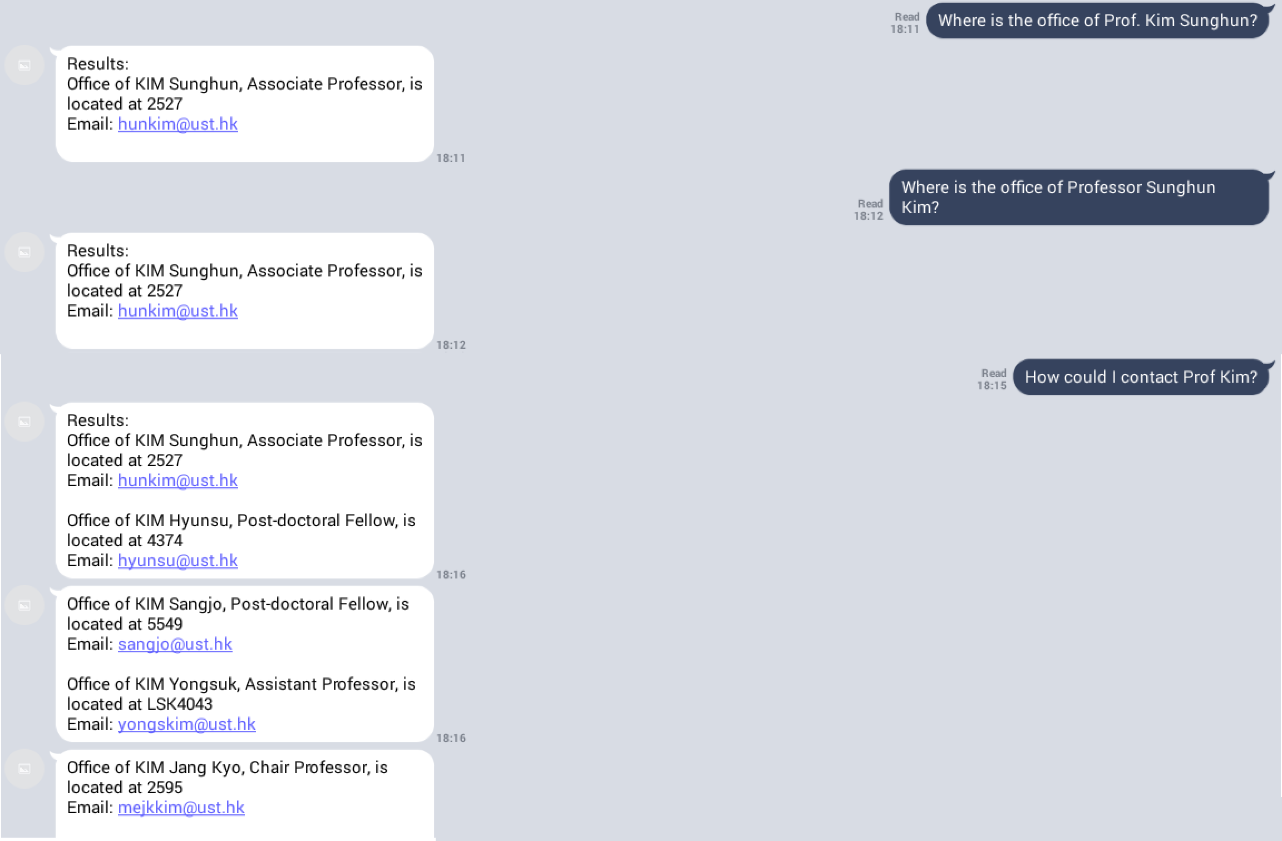
Academic <- Staff
- Help users find the office location, contact info of professor / TA

Slide 7
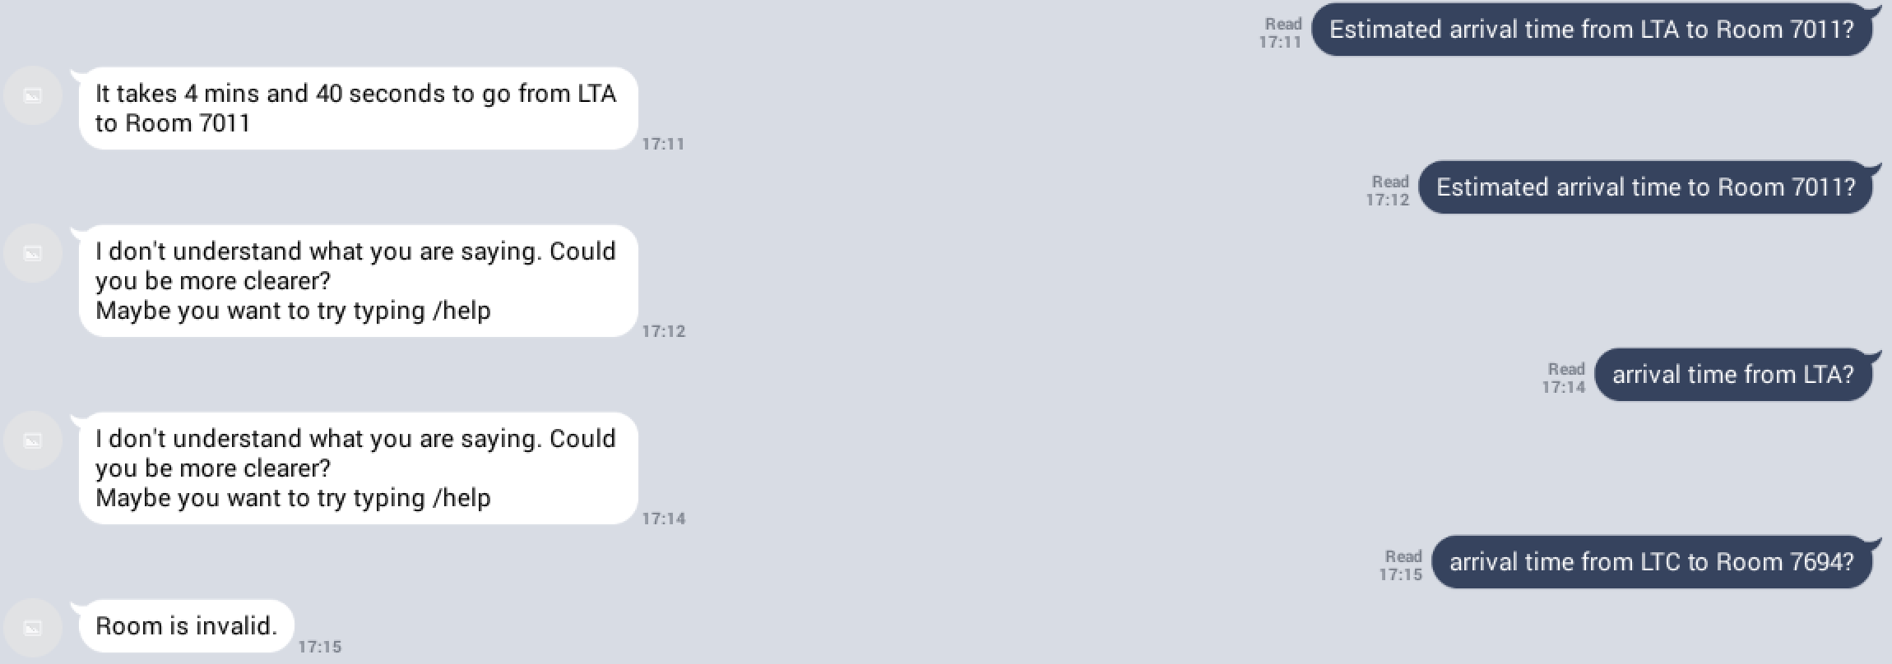
Campus <- CampusETA
Help users estimate the arrival time from one location to another throughout the UST campus
Data crawled from pathadvisor.ust.hk

Slide 8
Function <- TimeTable
- Assist users to manage their time effectively

Slide 9
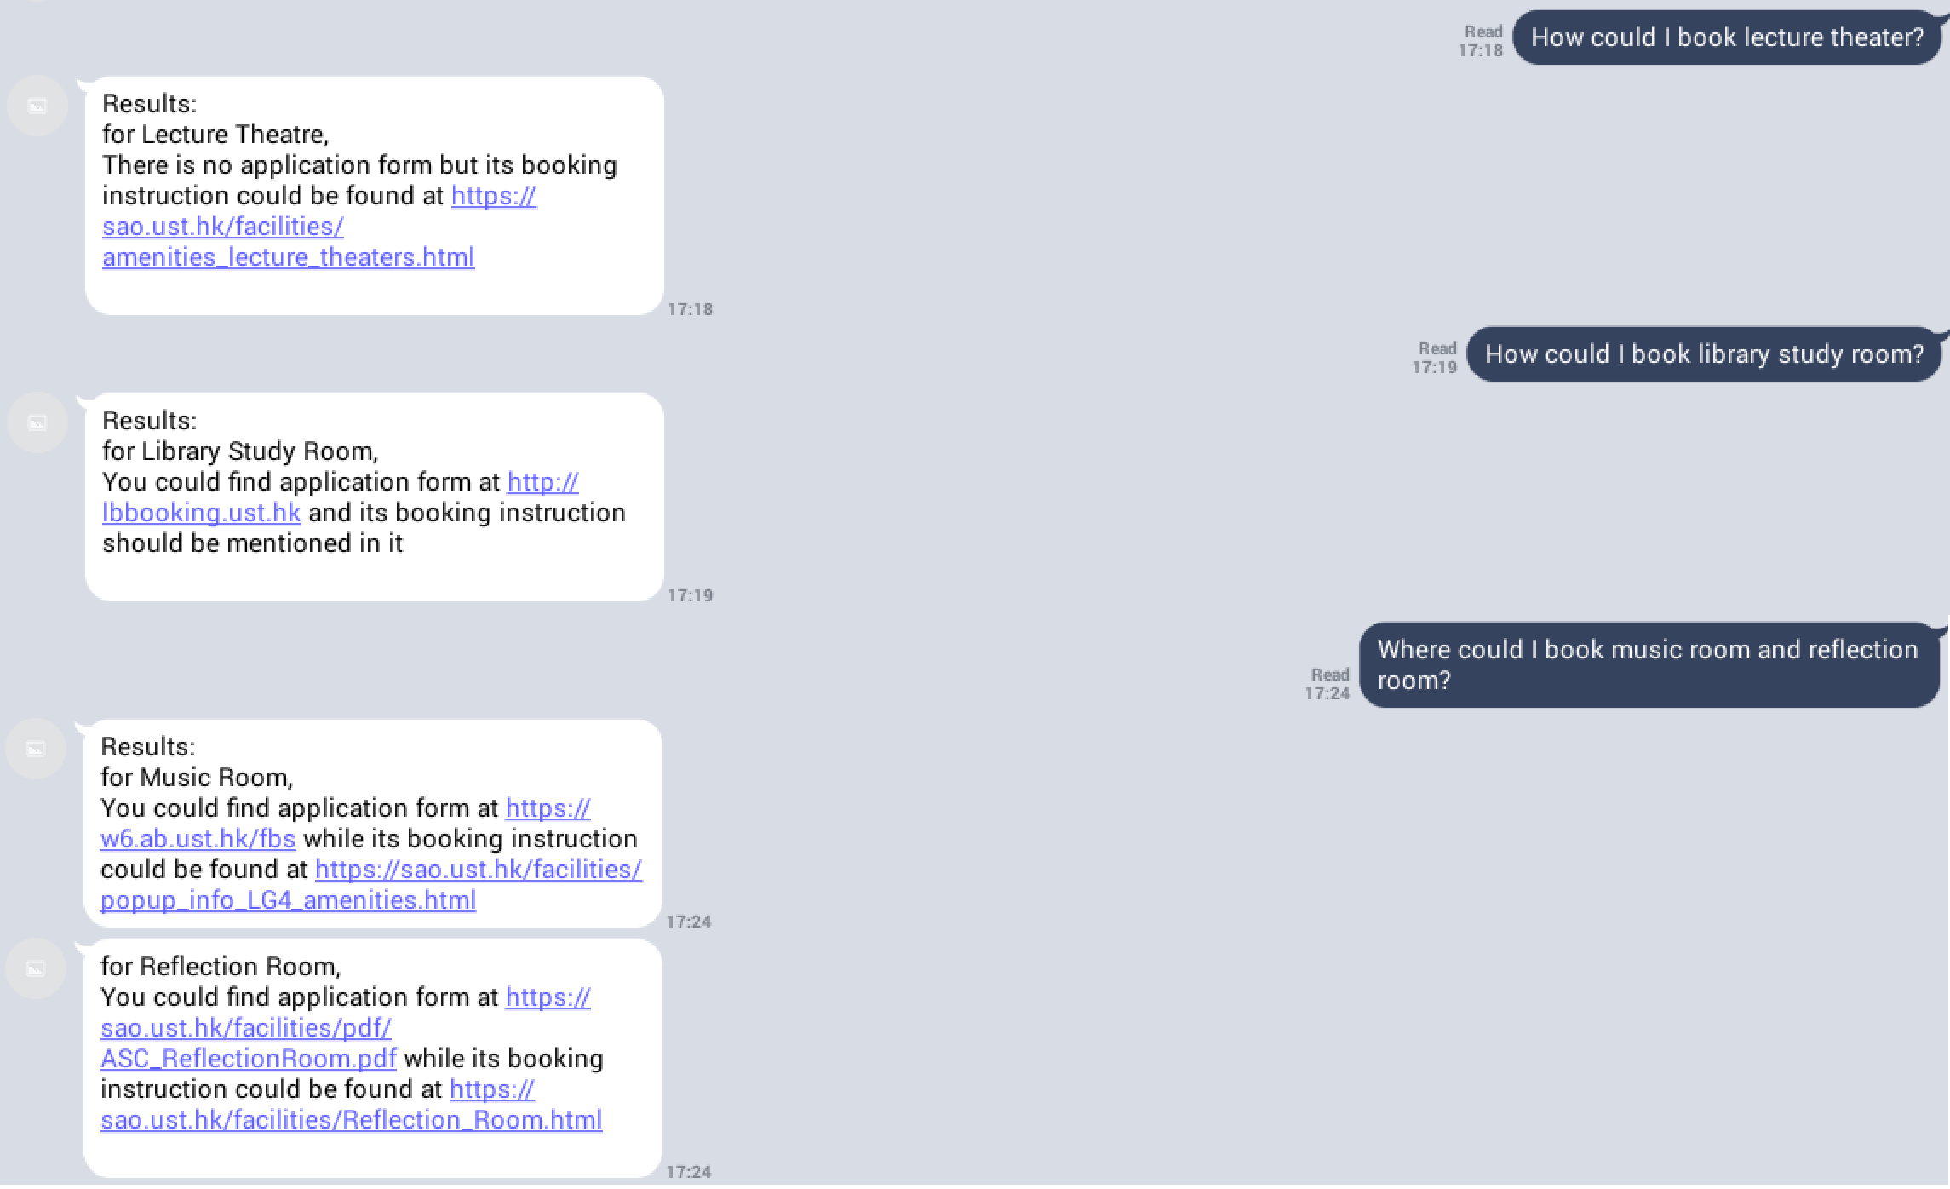
Social <- Recreation
Help users search websites for booking UST amenities, e.g. library study room, music room

Slide 10
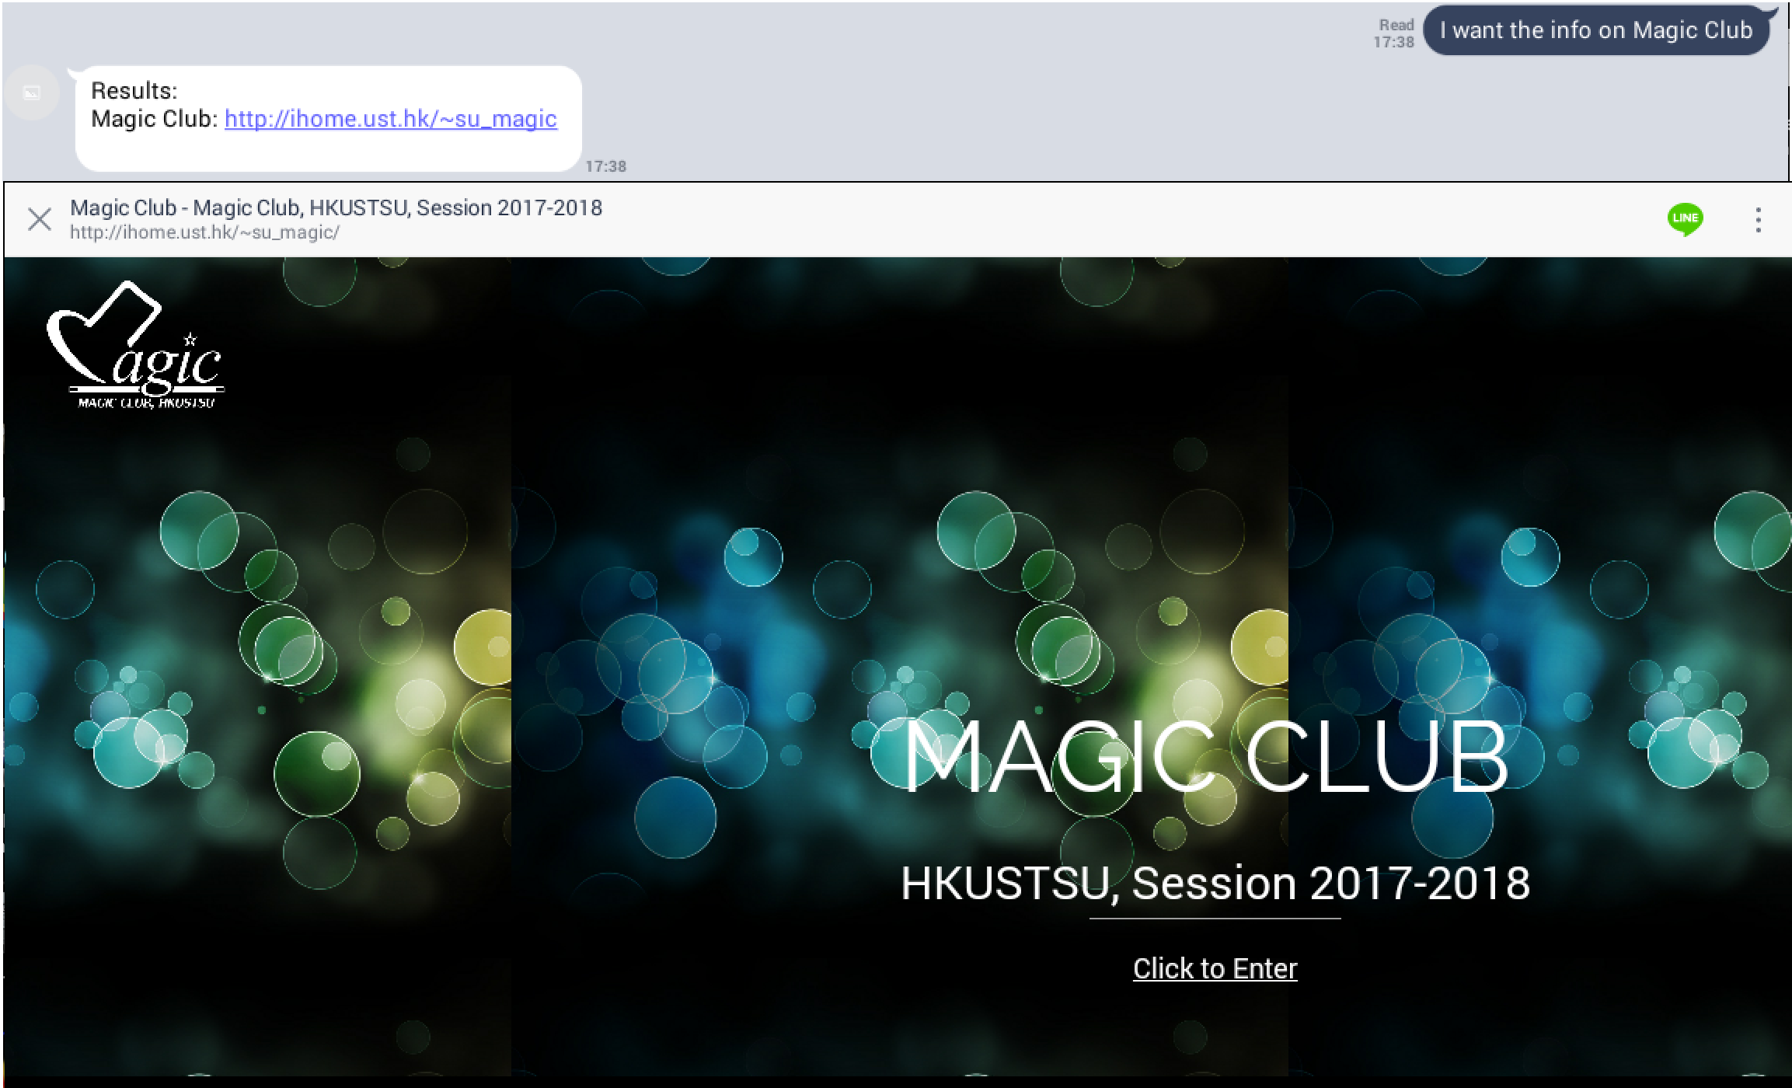
Social <- Societies
- Help users find webpages of UST societies, e.g. Debating Society, Drama Society

Slide 11
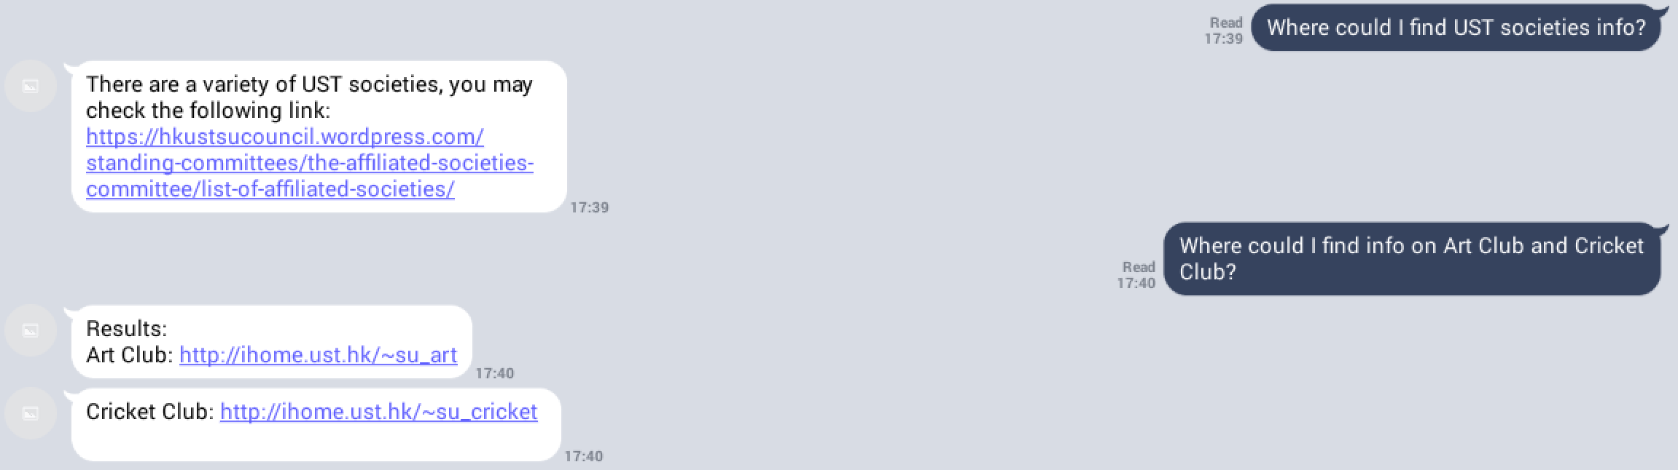

Slide 12
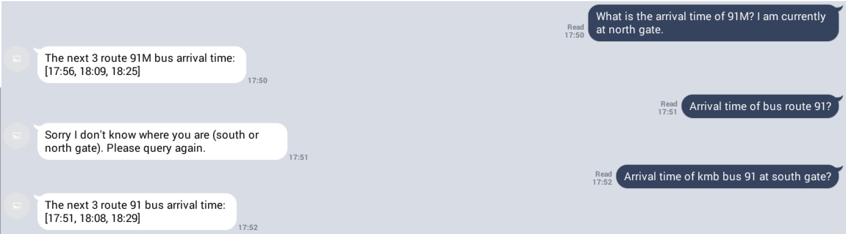
Transport <- Bus
Help users find estimated arrival time of bus route 91 and 91M at UST north gate / south gate based on current time
Arrival time are crawled from official KMB database

Slide 13
Transport <- Minibus
Help users find estimated arrival time of minibus route 11 based on current time
Minibus records are self-collected

Slide 14
Instruction
- Guide users how to properly use our chatbot

Slide 15
Design Pattern
Mediator
Each category has different functionalities
The Category class wraps all subcategories into a whole
better maintenance
Marker interface
Mimic java.lang.Serializable and java.lang.Clonable
Create two markers SQLAccessible, StaticAccessible to signify SQL database and Static database are available
Enhance readability

Slide 16
Algorithms / Libraries used
Wagner-Fischer’s Algorithm to handle users’ typos
JSON, Jsoup for web crawling
(Named Entity Recognizer)

Slide 17
Technical Difficulty
TimeTable feature
Vague LINE Message API documentation
Don’t know how to reply user at certain point in method (System.in)
Have to modify the whole class

Slide 18
Team Difficulty
Most of us only have few knowledge on Java Spring and Gradle
Huge workload, not only dealing with this course
Time constraint

